Slide 1
Transformers
ALY 6020 - Final Project
By - Archit Barua
Nikshita Ranganathan

Slide 2
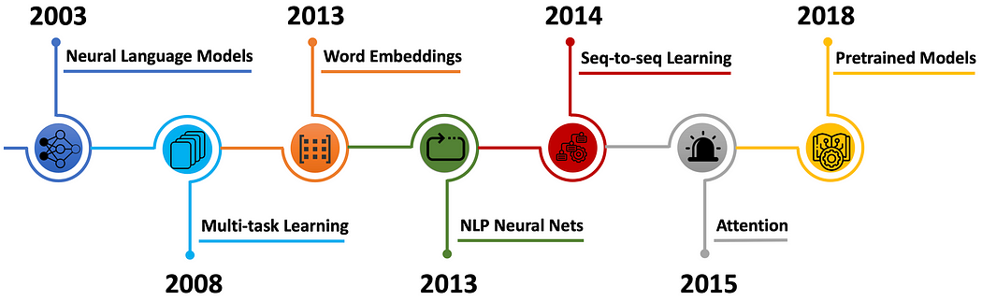
NLP History Timeline

Slide 3

Where it all started?
Shift from RNNs and CNNs to attention-based models
Key Contributions
Two components – Encoder, Decoder

Slide 4
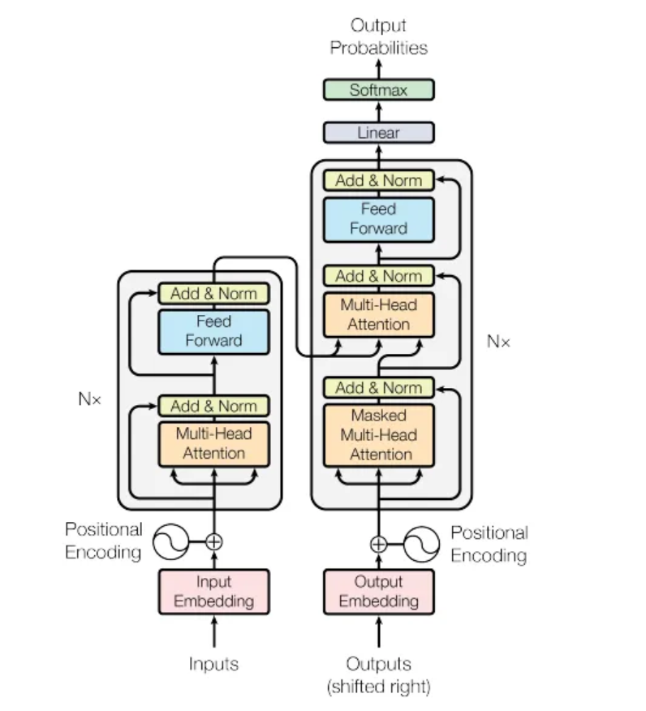
Transformer Architecture

Slide 5




Limitations of RNNs & LSTMs
Overfitting
Time -
Consuming
Memory Limitations
Challenges with Parallelization

Slide 6
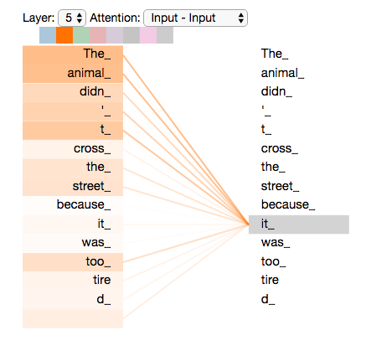
Self-Attention Mechanism Overview
Dynamically adjusts word representation by aggregating information from all other words.
Enhances contextual understanding by considering inter-word relationships.
Captures long-range dependencies efficiently, surpassing RNNs and LSTMs.
Crucial for deep language context understanding in various NLP tasks.
Notes:
"Let's delve into self-attention, a pivotal mechanism allowing each word in a sentence to interact with every other word. This interaction is key to understanding nuanced context and resolving ambiguities in language. For instance, consider the sentence 'The trophy didn’t fit in the suitcase because it was too big.' Self-attention helps the model determine 'it' refers to the trophy, not the suitcase, by analyzing the entire context. This mechanism surpasses traditional models by efficiently capturing relationships, no matter the distance between words in the text." This visualization represents the attention patterns within a single head of the model's multi-head attention mechanism. We're looking at how the word 'it_' receives attention from all other words in the sentence."
"The intensity of the color or the width of the lines indicates the strength of the attention. You can see that 'it_' is closely attending to 'animal_', which suggests that the model is learning the correct reference for 'it_' in this context."
"Such attention patterns are crucial for the model to understand sentence structure and resolve references, which is especially important in translation, summarization, and other language tasks that require a nuanced understanding of context."
"This layer-specific view gives us an insight into what the model is focusing on at a particular stage of processing. It's like a glimpse into the thought process of the AI as it interprets the sentence."

Slide 7
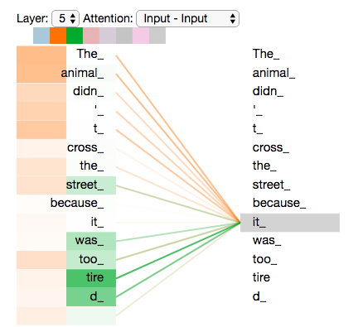
Multi-Head Attention
Consists of multiple parallel attention layers, enriching input data representation.
Each 'head' captures different aspects of sentence, enhancing data representation diversity.
Increases model capacity by providing multiple 'views' of input, improving feature disentanglement.
Boosts learning capability, making the model more robust and versatile.
Notes:
"Multi-head attention can be thought of as having multiple sets of eyes, each providing a unique perspective on the input data. By processing information in parallel, the model captures a diverse range of relationships within the same sentence. Imagine one head focusing on the emotional tone of a sentence while another deciphers the grammatical structure. This multifaceted approach enriches the model's understanding, making it adept at handling complex linguistic tasks and enhancing its interpretative depth."
"This slide illustrates a key feature of the transformer model: multi-head attention. Here, we see different 'attention heads' focusing on the word 'it_' within a sentence."
"Each line represents the 'attention' one head pays to 'it_' from each word in the sentence. The varying colors or shades might represent different attention heads, showing how the model processes information from multiple perspectives simultaneously."
"Notice the stronger lines from 'animal_' and 'tired_', indicating a higher attention weight. This suggests that certain heads are learning to associate 'it_' with 'animal_', which is likely the correct reference in this context."
"Multi-head attention allows the transformer to capture a more nuanced understanding of language. It's like having several readers, each interpreting the sentence in different ways, and then combining their insights to form a comprehensive view."

Slide 8
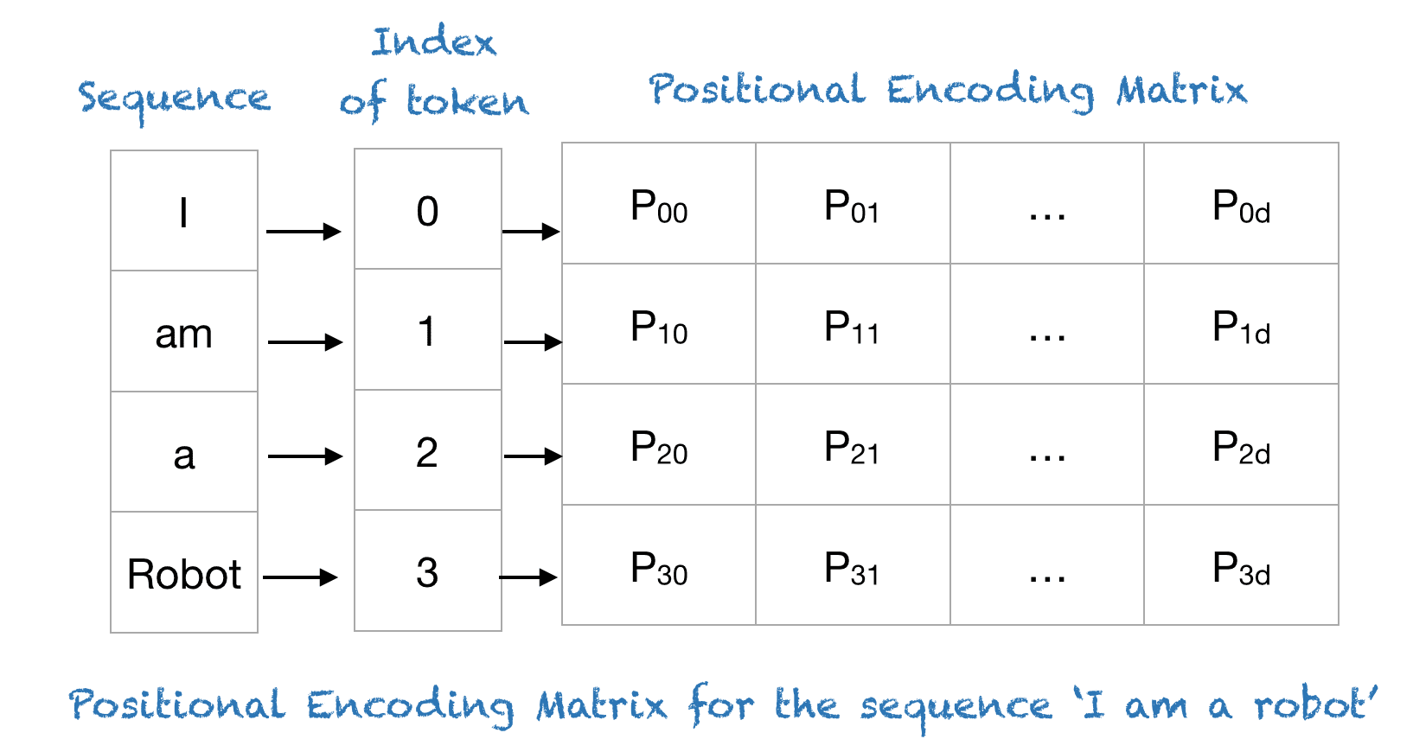
Positional Encoding
Injects position information into the sequence, crucial for sequence order understanding.
Utilizes sine and cosine functions for unique positional signals.
Ensures preservation of word order, critical for syntactic and semantic understanding.
Seamlessly integrates with transformer architecture, maintaining compatibility.
Notes:
"Positional encoding is our solution to imbue the transformer with a sense of word order, crucial for comprehending structured language. Through a clever use of sine and cosine functions, we generate unique signals for each position, ensuring the model recognizes the difference in meaning between 'John loves Mary' and 'Mary loves John.' This method integrates seamlessly into the transformer framework, preserving the integrity of sequential information in a model that inherently lacks sequence awareness." This image illustrates positional encoding vectors for the sequence 'I am a robot.' Each word in the sequence is assigned a unique position index, starting from 0."
"The matrix on the right contains the positional encoding vectors. Each vector is a high-dimensional representation of a word's position in the sequence. The 'P' values (like P00, P01, ..., P3d) are the elements of these vectors."
"Positional encodings are crucial because they provide the transformer model with information about the order of words, which is otherwise not apparent due to the parallel nature of the model's processing."
"These vectors are added to the word embeddings, ensuring that the sequence's order contributes to the model's understanding of the sentence. It's a key part of how transformers maintain an awareness of word order, which is fundamental in processing natural language."

Slide 9

Why Transformer is the Future
Achieves state-of-the-art results in numerous NLP benchmarks.
Scalable and efficient architecture enables reduced training times.
Applicable across various domains, demonstrating versatility.
Serves as a foundation for groundbreaking models, propelling AI research.
Notes:
In concluding, the transformer model isn't just a breakthrough; it's the blueprint for the future of AI. Its unparalleled performance across NLP tasks and beyond is setting new benchmarks. The efficiency and scalability brought about by its parallel processing capabilities open up new horizons for handling vast datasets. Moreover, its influence extends across AI domains, inspiring innovations in understanding not just language, but also images and sounds. As we continue to build on this foundation, the potential for transformative advancements in AI is immense."

Slide 10
Thanks!

